Slide 1
Heathiest and unhealthiest cities in USA for travelling
Coursera Capstone
IBM Applied Data Science
Namrata Dwivedi (2020)

Slide 2
Business problem:
The objective of this project was to analyses the top healthiest and unhealthiest city in USA and figure out how the above four factors play a key role in the wellness of the people who wish to travel in these cities.
The researchers have calculated overall scores for each city based on a weighted average of all metrics.
So, the next time you want to travel across USA and stay healthy the best way is to watch out for these factors to enhance your travelling experience.

Slide 3
Data
1.The data for the healthiest and unhealthiest cities in the USA will be obtained from wallet hub. The latitudes and longitudes are required to build an interactive map of the cities. https://wallethub.com/edu/healthiest-cities/31072/
The healthiest city is San Francisco, we will need the neighborhood of the city along with the latitude and longitude. It will be obtained by https://en.wikipedia.org/wiki/List_of_neighborhoods_in_San_Francisco and python Geocoders package.
Similarly, the unhealthiest city is Brownsville in Texas. The data will be obtained in the similar manner as mentioned above

Slide 4
Methodology:
Web scraping wallet hub and Wikipedia pages for the neighborhood of San Francisco and Brownsville Texas.
Geocoders will give us the latitude and longitude.
Create interactive map of USA showing location of 174 cities.
Plot graph of two cities taking various factors
Use Foursquare API will get the specific Venue details.
Compare results of the two cities.

Slide 5
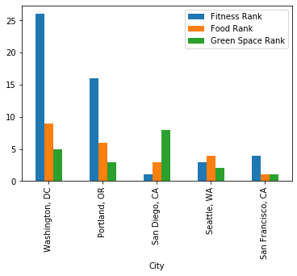
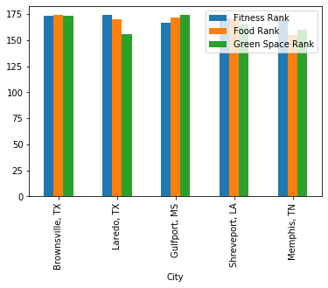

Slide 6
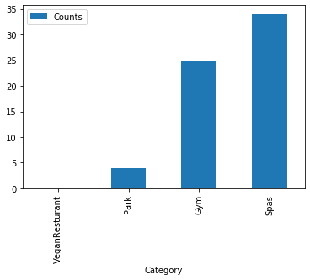
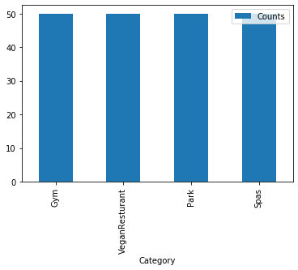
Result:
Brownsville Texas
San Francisco
San Francisco, which is the healthiest city, has more green spaces like parks to cater to people’s health. The vegan and vegetarian food choices are unlimited. We can also see that there are many spas and gyms in its neighborhood overall, it’s a perfect travelling destination Unlike Brownsville Texas.
Brownsville Texas is the unhealthiest city in the USA. Though we can find spas and gyms in its neighborhood, but these two factors are not the only factor which need to be considered while travelling

Slide 7
Discussion:
Brownsville had the lowest percentage of physically active adults of any US city.
It also has the fewest number of healthy restaurants. Brownsville also lacks walking trails, running trails per capita. Brownsville scored an overall health score of 21.41
San Francisco scored an overall health score of 73.99
It beat out all other cities for having the most walking trails per capita, tied for first for having the most running trails per capita.
It ranks fourth for having the most healthy restaurants per capita

Slide 8
Limitations:
The foursquare API has limited access for non-paid users.
We also did not consider the health care rank as the data for health care system was unavailable to us.
If did not compare all the cities in the USA, then our project would be more meaningful. We can further investigate our finding from Foursquare paid account to bypass all these limitations.

Slide 9
Conclusion:
In this project we have made an effort to summarize the travelling experience in the healthiest and unhealthiest city in the USA. map. Various location like restaurants spas parks and gyms are explored in the neighborhood of the cities and compared with each other. The findings of these projects will help the travelers explore the scope and limitation of the region with respect to various parameters.

